Slide 1





YASHWANTRAO CHAVAN MAHARASHTRA OPEN UNIVERSITY, NASHIK.
TATTOO VERSE
(Tattoo Artist Booking Web Application)
By
OMKAR YUVRAJ MHASKAR (PRN No: 2022017001363414)
SAGAR RAVI KOTA (PRN No: 2022017001363437)
Win Informatics Network, Kalyan 35116

Slide 2









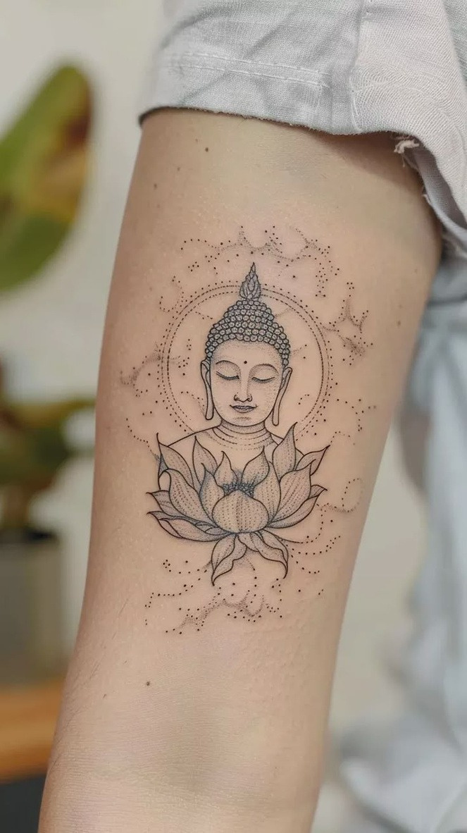
We believe tattoos are more than ink – they are powerful expressions of identity and creativity.
Our skilled team specializes in diverse styles, ensuring each tattoo is a personalized masterpiece.
We focus on comfort, safety, and making your tattoo experience smooth, exciting, and memorable.
We strictly follow health protocols, using sterilized equipment for every session to ensure your safety.

Slide 3



Tattoo Verse
Create exceptional, long-lasting tattoos with precision and artistic excellence.
Maintain the highest health and safety standards with
sterilized equipment and a clean environment.
OBJECTIVE
Work closely with clients to turn their ideas into custom,
meaningful tattoo designs.
Ensure every client feels relaxed, respected, and confident
throughout their tattoo journey.
Continuously learn and adapt new tattoo styles, tools, and
technologies to offer the best service.

Slide 4
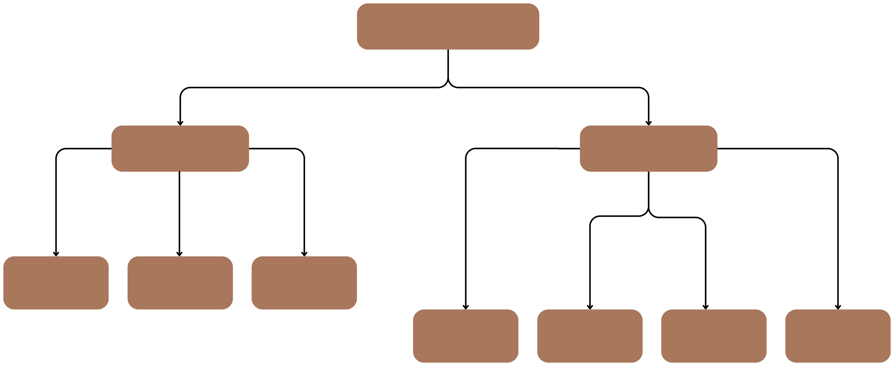
Tattoo Verse
Admin
User
Manage
Appointment
Confirm Appointment
Add/Delete Artists
Register
View Products
Book Appointment
Gallery

Slide 5
SOFTWARE/HARDWARE USED FOR DEVELOPMENT
Hardware Requirements:
• Windows 10 or Higher Version
• Processor speed: 3.0 GHz RAM : 4GB
• Hard disk: 100 GB hard Disk.
Software Requirements:
• Database: MySQL
• Server: XAMPP Server
• Scripting Language: JavaScript, CSS, HTML and Bootstrap
• Back end: PHP

Slide 6

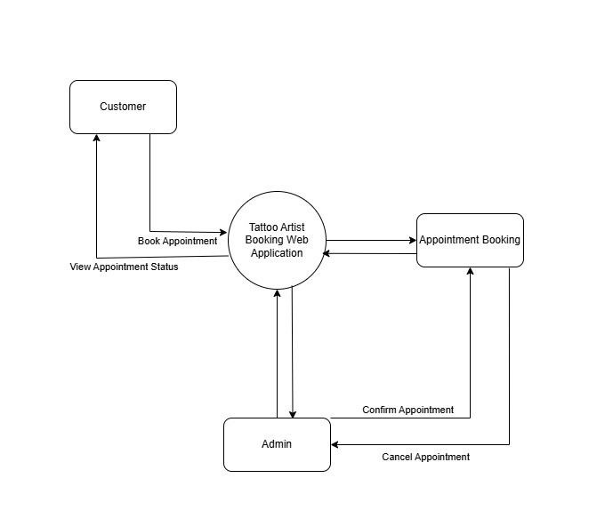
DFD: 0 LEVEL

Slide 7


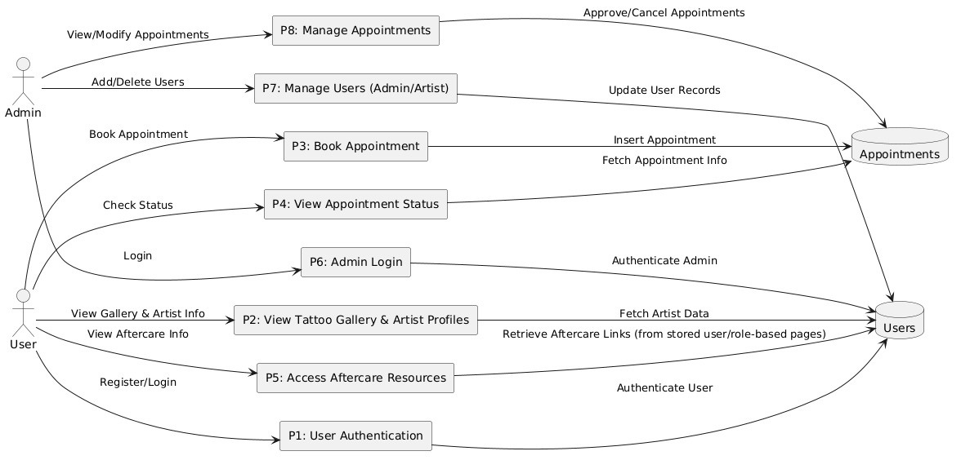
DFD: 1 Level

Slide 8


.User .Appointments
TABLES

Slide 9
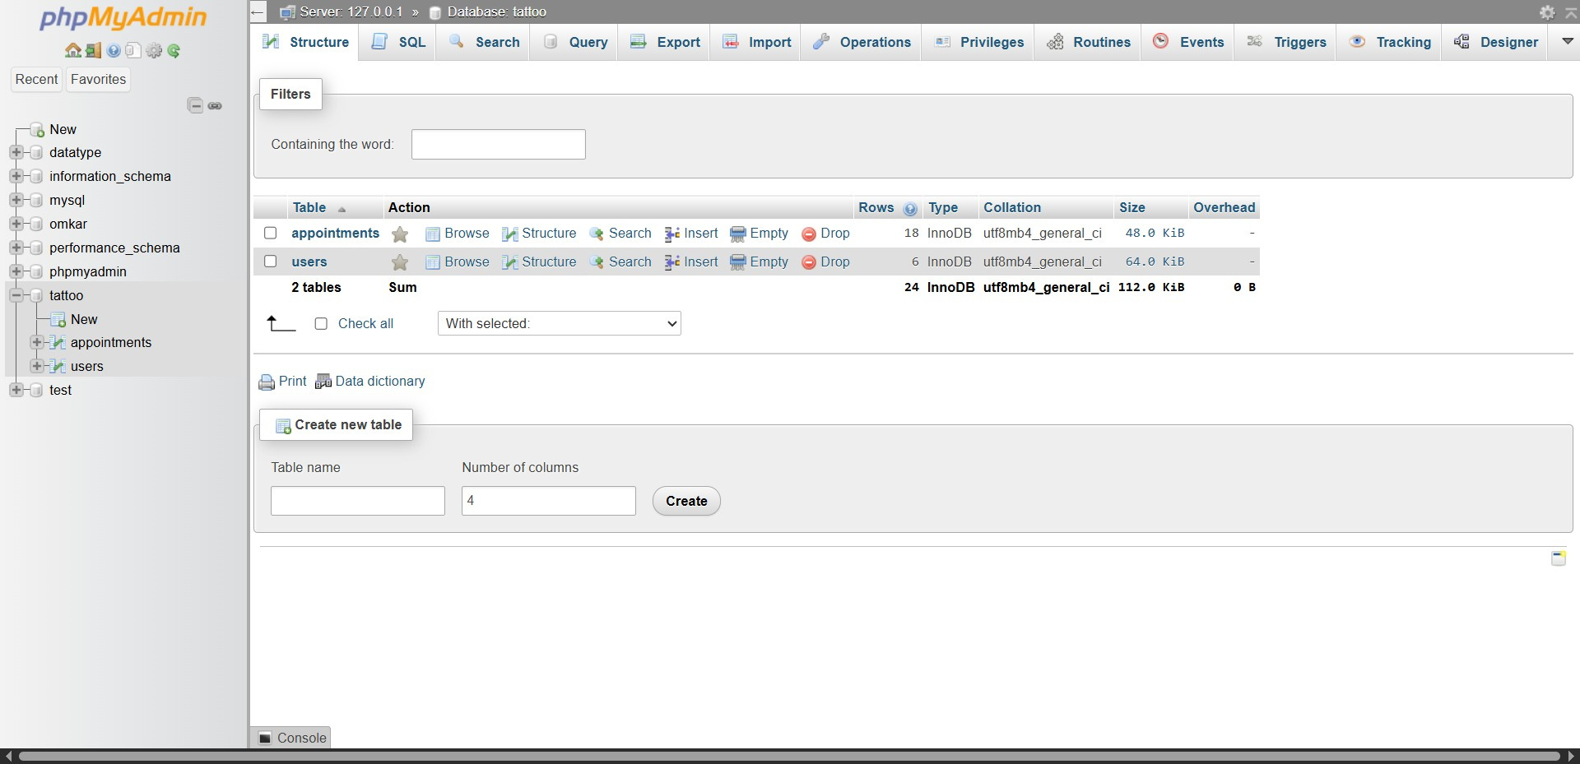
DATA TABLES:

Slide 10

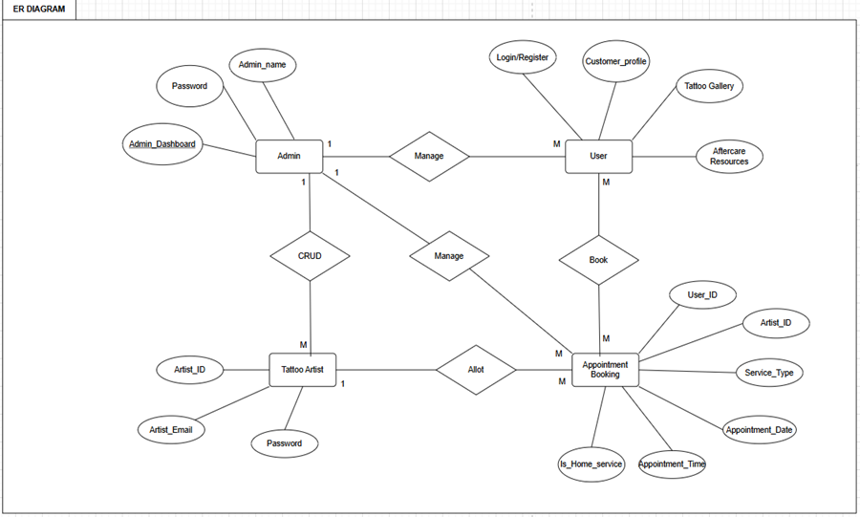
ER DIAGRAM

Slide 11

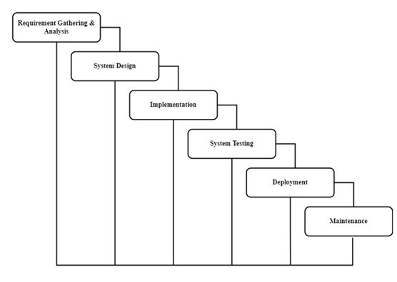
WATERFALL MODEL

Slide 12

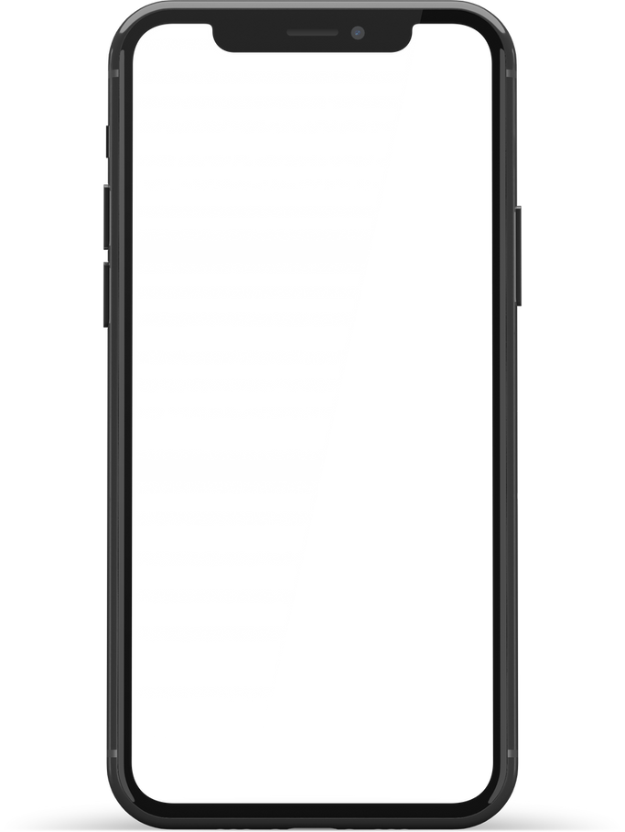

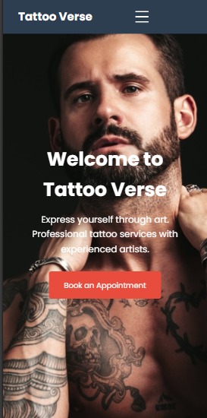
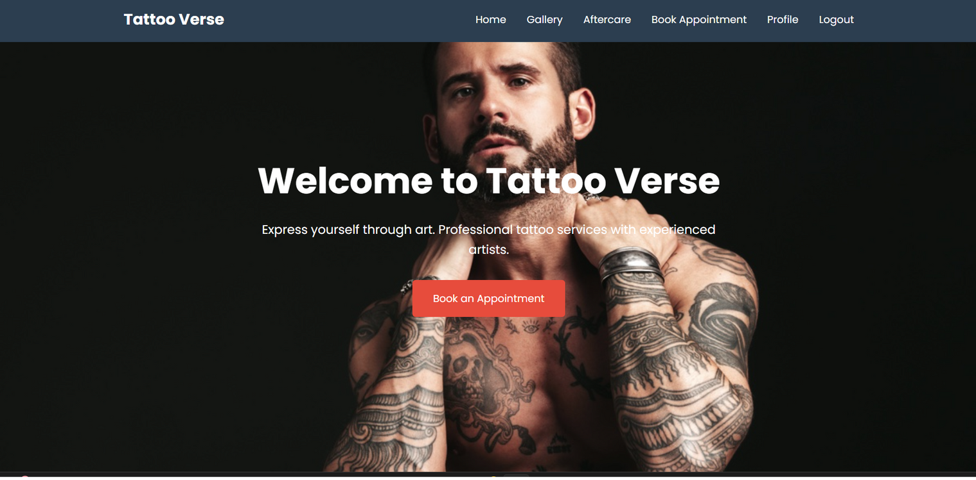
INTERFACES

Slide 13

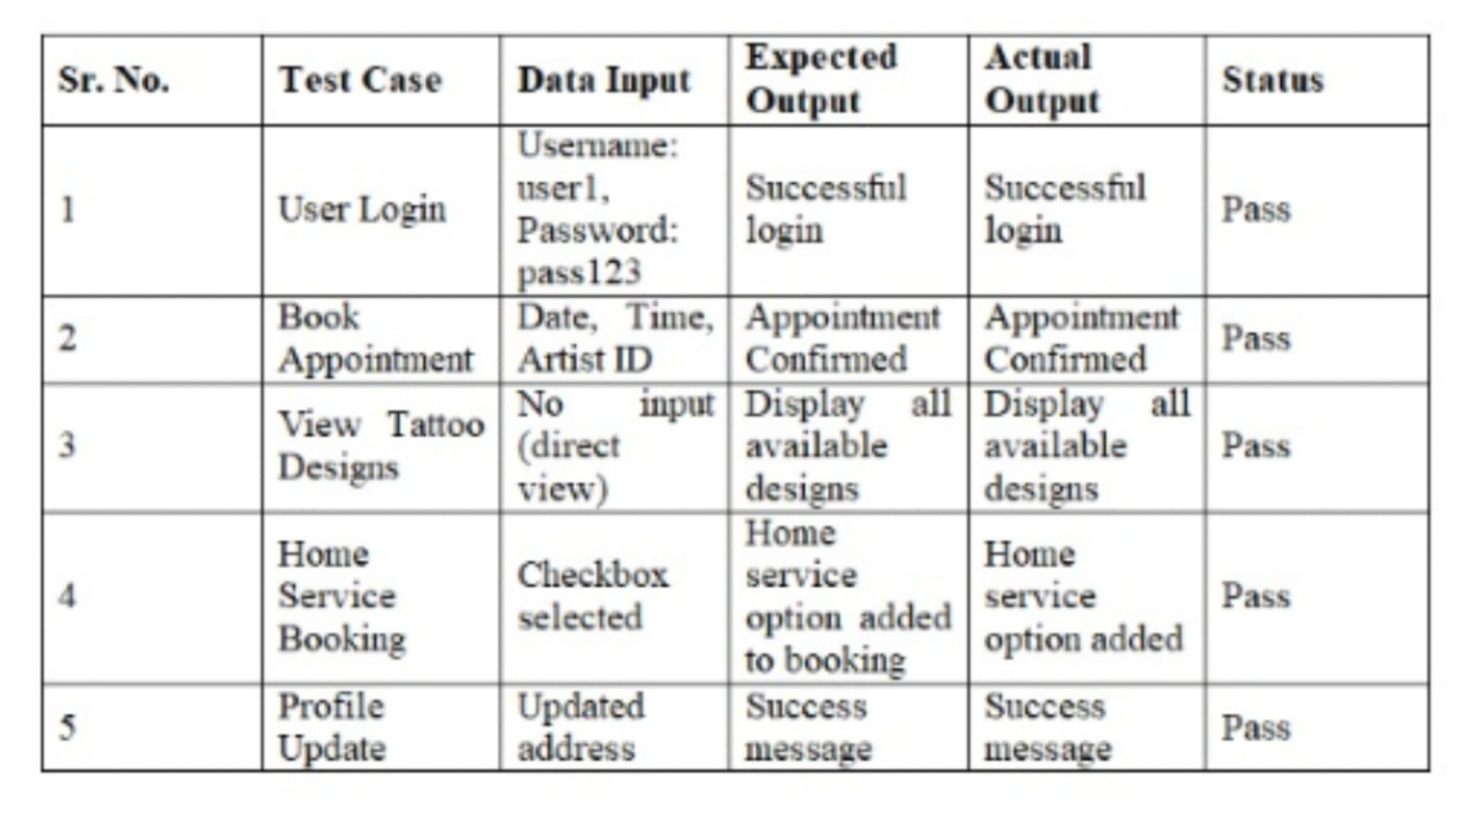
SYSTEM TESTING
(UNIT TESTING)

Slide 14


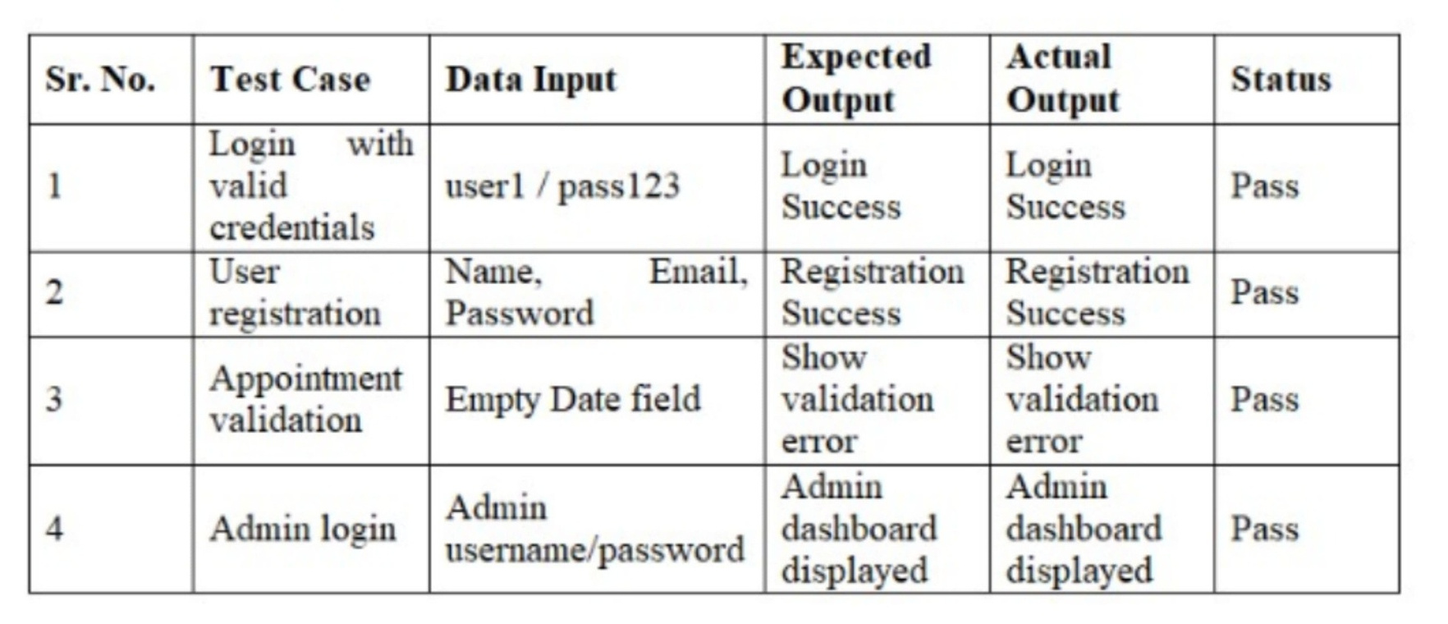
VALIDATION TESTING

Slide 15


CONCLUSION
The Tattoo-Verse: Tattoo Artist Booking Web Application presents a modern, digital solution for managing tattoo appointments, artist portfolios, and aftercare resources in a centralized and user-friendly platform. By shifting from traditional manual booking methods to a fully web-based system, Tattoo-Verse offers users and administrators a faster, more efficient, and more accessible experience. The platform simplifies the process of connecting clients with tattoo artists, allows for easy viewing of existing tattoo designs, and ensures that appointments and services are well-organized.

Slide 16


FUTURE SCOPE AND PLANS
We have 3 key plans to expand the Tattoo Verse:
Expand Tattoo Styles and Techniques
Introduce advanced styles like 3D tattoos, eye tattoos.
Launch Workshops and Training Offer professional courses and mentorship programs for aspiring tattoo artists.
One of the standout features planned for the mobile version is the integration of Virtual Reality
(VR)
filters, allowing users to preview how tattoo designs would look on different parts of their body
before making a decision

Slide 17

YouTube:
Channel Name: Bro Code Video Link: https://www.youtube.com/watch?v=zZ6vybT1HQs&t=38s
Channel Name: freeCodeCamp.org Video Link: https://www.youtube.com/watch?v=-qfEOE4vtxE
Channel Name: Tech Gun Video Link: https://www.youtube.com/watch?v=QE5oQh63gGE
Channel Name: CodeWithHarry Video Link: https://www.youtube.com/watch?v=BsDoLVMnmZs
Channel Name: Apna College Video Link: https://www.youtube.com/watch?v=VlPiVmYuoqw
BIBLIOGRAPHY

Slide 18
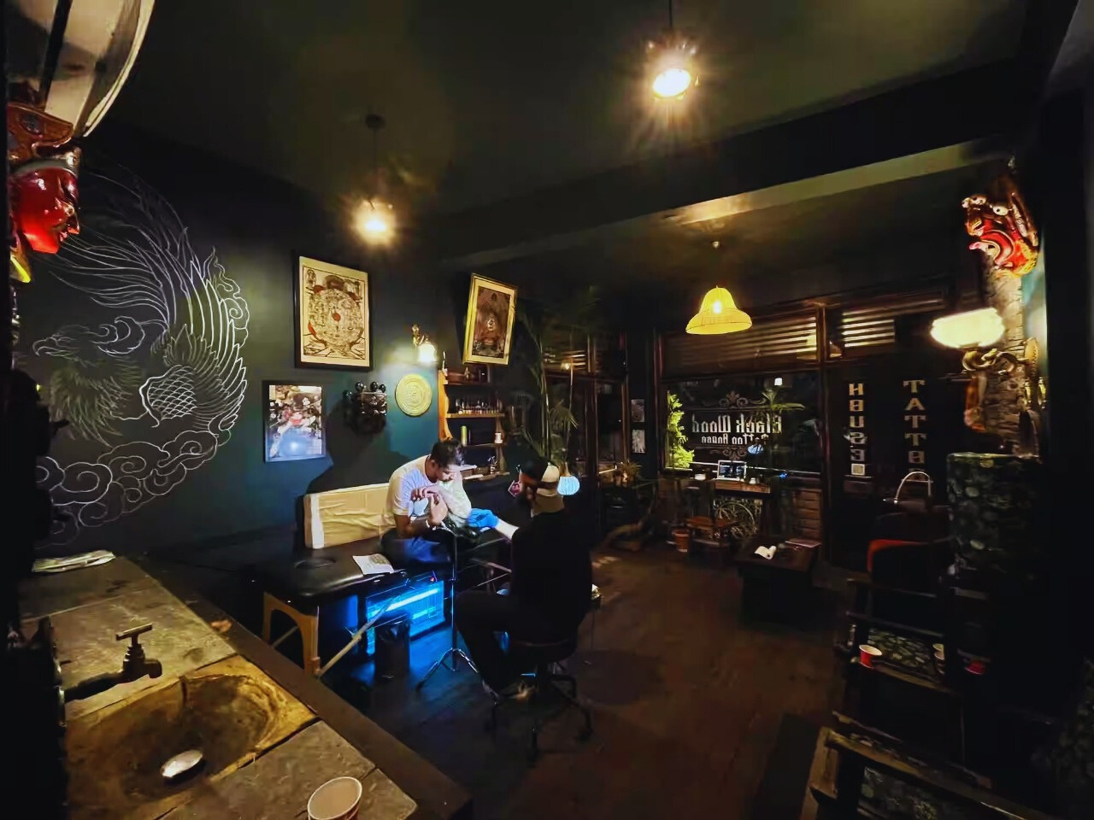



Thank You

